Slide 1
Mechatronics Project Autonomous Guided Vehicle Supervised by - Prof. Dr.-Ing. Jörg Wollert, Victor Chávez-Bermúdez
06. April 2022
-Aadithya Ramamurthy, Michael Knoll, Rachana Kodilla, Sameer Tuteja & Vedhashruthi Harinath

Slide 2
Outline
Motivation & Starting Point
System Design
ROS
PLC
Power Supply
Motor Controller
Conclusion & Outlook

Slide 3
Motivation & Starting Point Introduction
Great demand to connect the workstations in the Industry 4.0 model factory at the AMA.
Task to design, build and test an autonomously driving shop floor delivery vehicle.
Carry a load of 100kg
Costs a maximum of 4000€
Being industry compliant

Slide 4
Motivation & Starting Point Introduction
Most Components already selected and purchased.
System Design made.
Requirements
Obstacle detection and step detection
Line following and station detection (Stage 1)
Localisation and autonomous movement (Stage 2)
ROS Communication

Slide 5
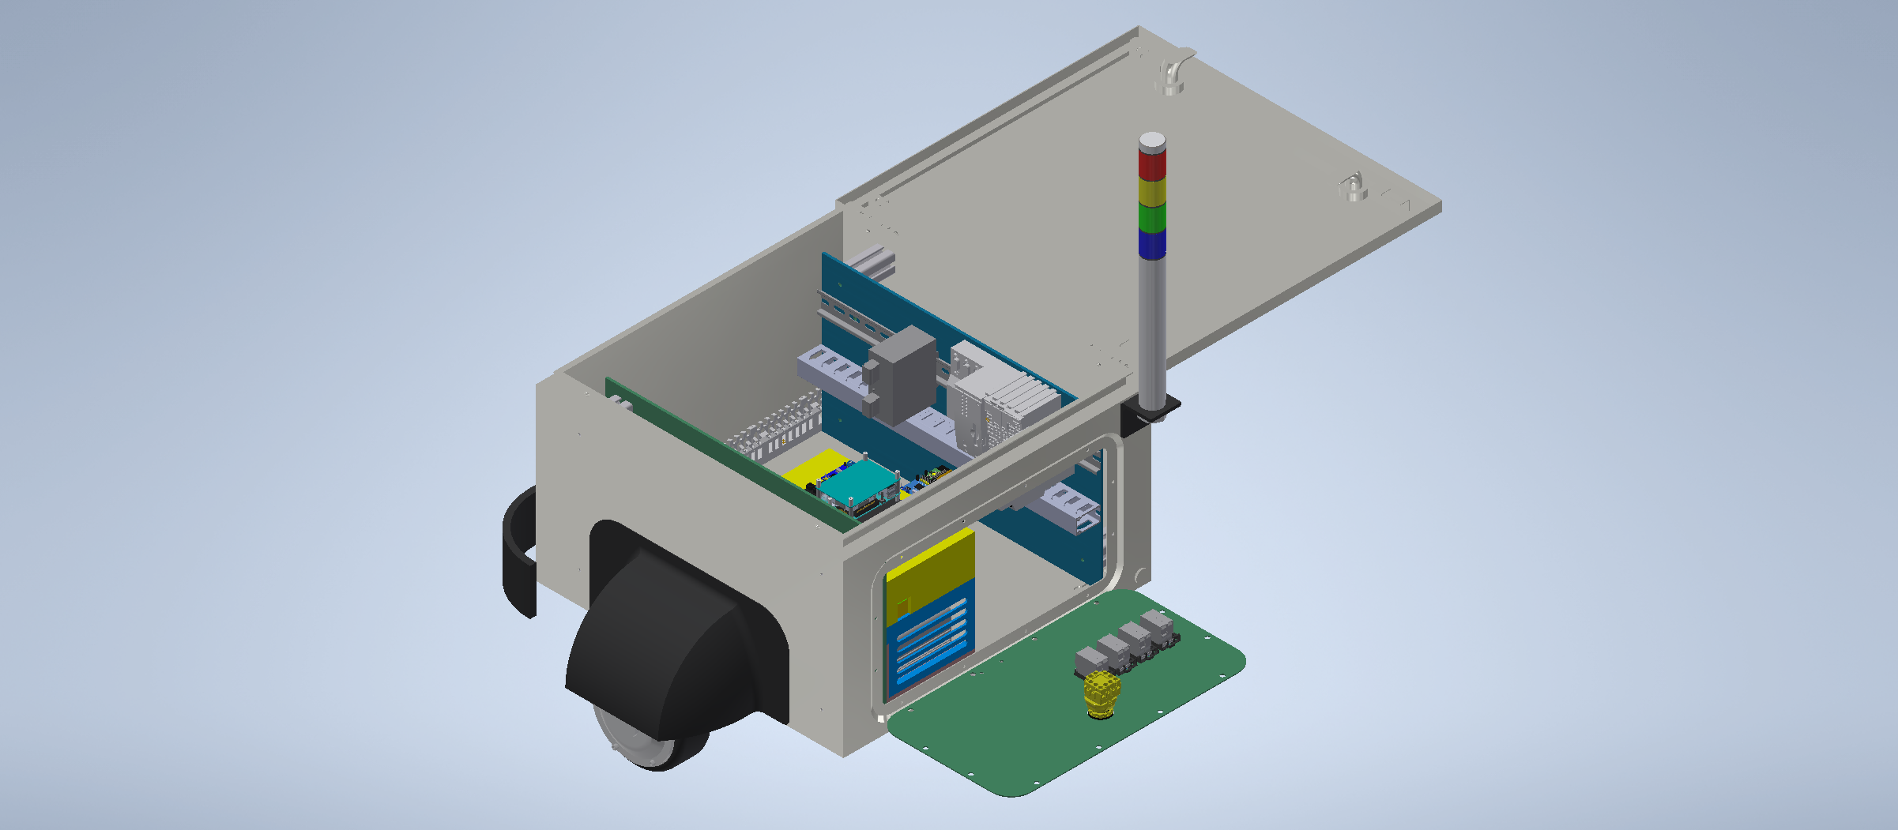
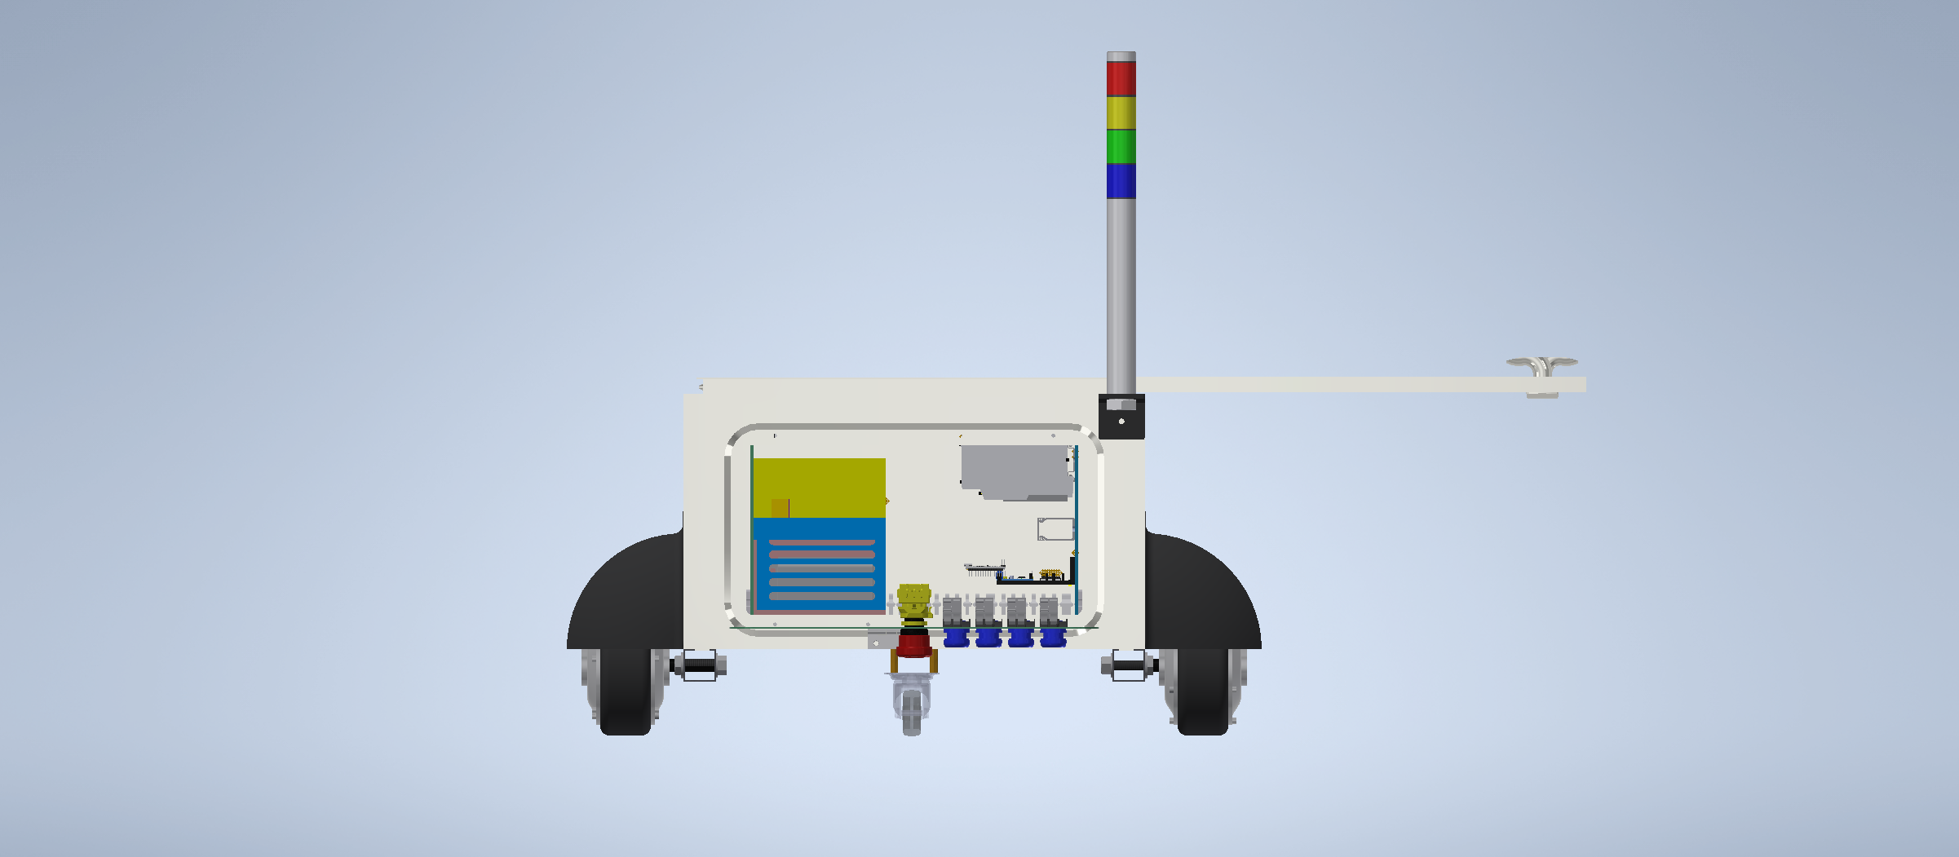
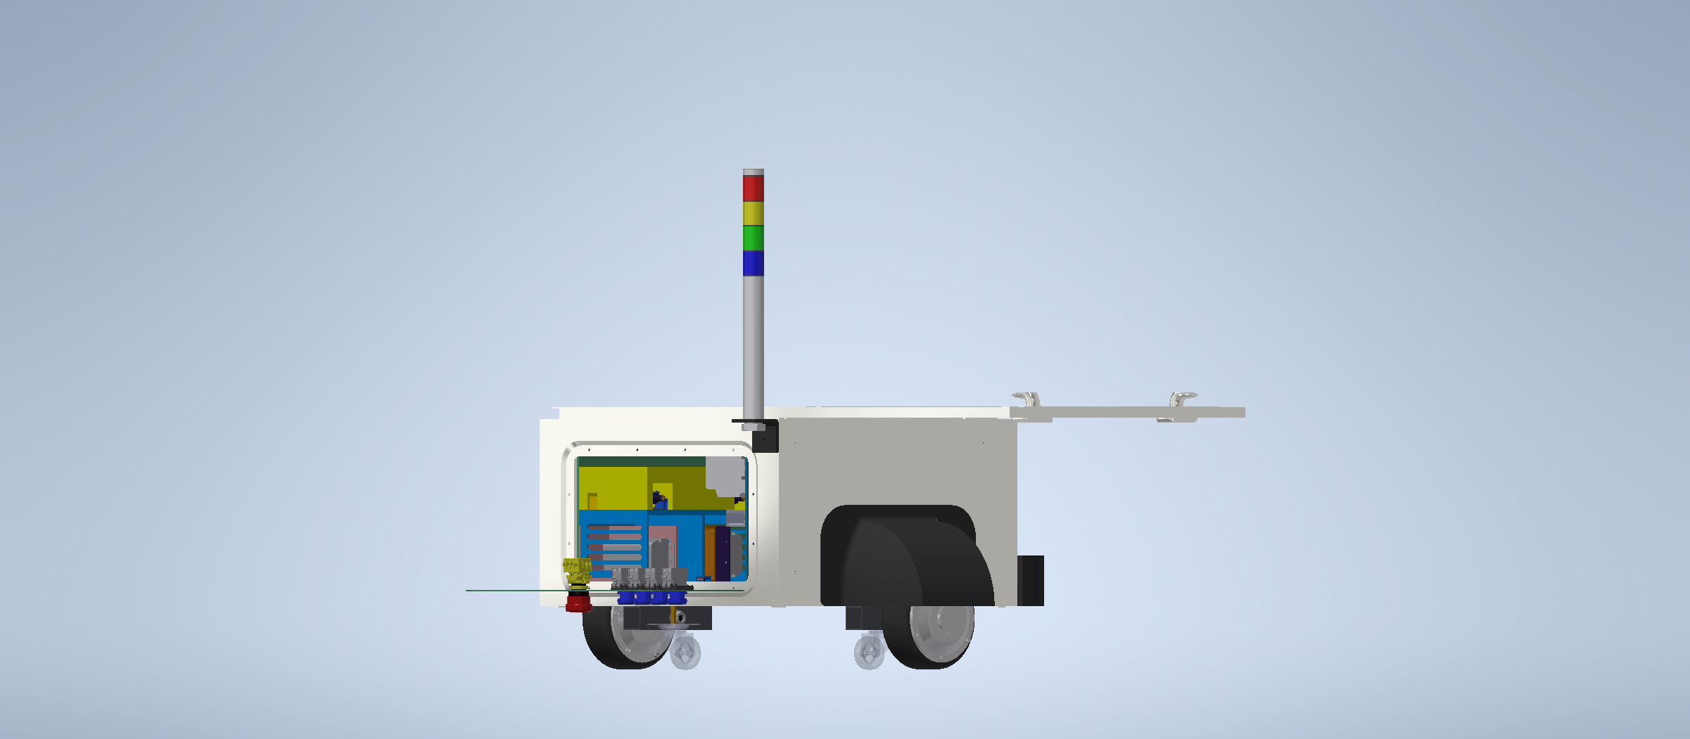
Motivation & Starting Point 3D Model

Slide 6
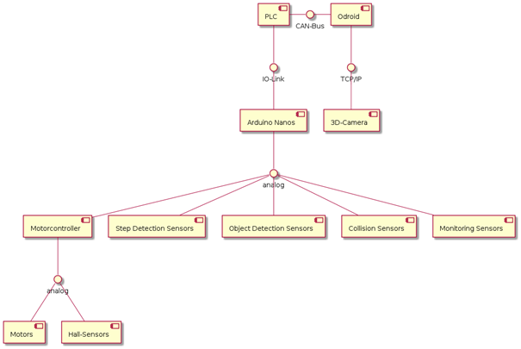
Motivation & Starting Point Initial System Diagram

Slide 7
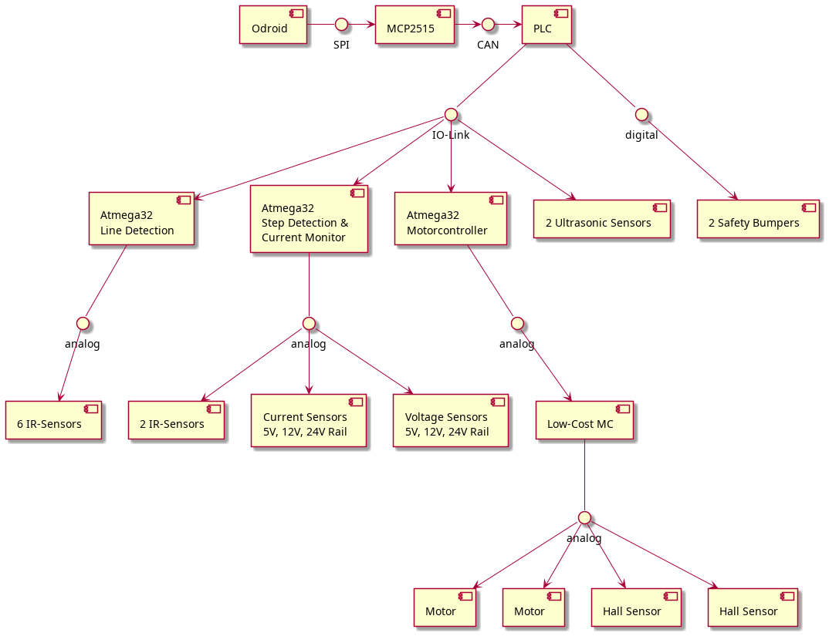
Motivation & Starting Point System Diagram Reviewed

Slide 8
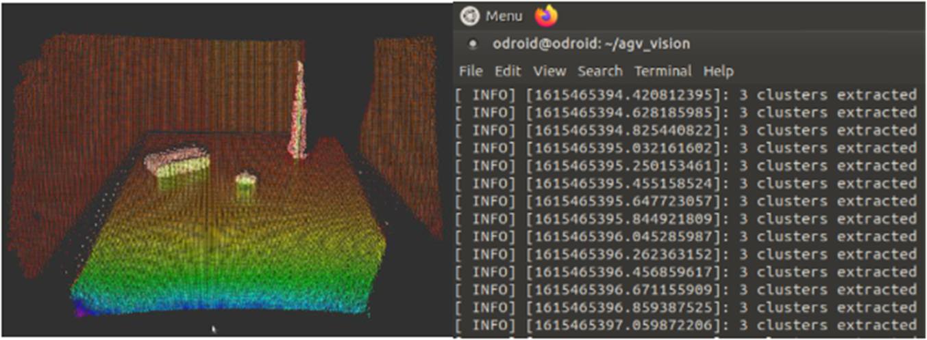
ROS Obstacle detection
•Obstacle detection using IFM 3D Camera was tested which was done by the previous groups.
•Planar segmentation and Eucldianclustering was done on the point cloud image to detect the objects as clusters.

Slide 9
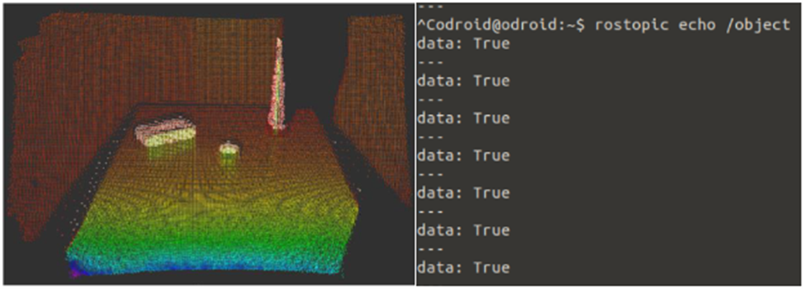
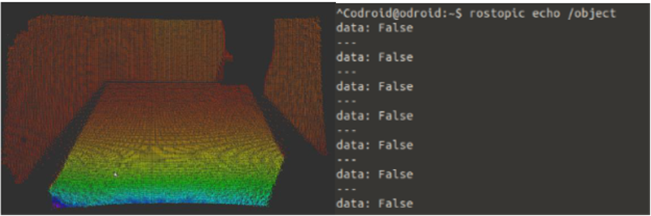
ROS Obstacle detection

Slide 10
ROS Obstacle detection
• A Boolean variable is used and set to false if number of clusters are zero and true if its greater than zero.
• This was published on a topic and a subscriber to this topic was used to send messages regarding the presence of obstacles

Slide 11
ROS Line following
Since 3D camera was used for Obstacle detection, it was also tested if it can work for line following.
The OpenCV version that is supported with ROS melodic was installed on ODROID.
Image processing of the amplitude stream was carried out using the HSV filtering and masking to detect the line.

Slide 12


ROS Line following
Amplitude stream from IFM 3D camera
Image after HSV filtering and masking

Slide 13
ROS Line following
Issues
The further objects were not in the image and appeared to be black and hence the HSV masking was also done for that part of the image.
The IFM 3D camera gives a point cloud image and not the regular optical or RGB image to work with for image processing.

Slide 14
ROS Line following
Conclusion
Using optical camera with IR sensors for line detection.
Using IFM camera for obstacle detection and further can be used for mapping and localisation.

Slide 15
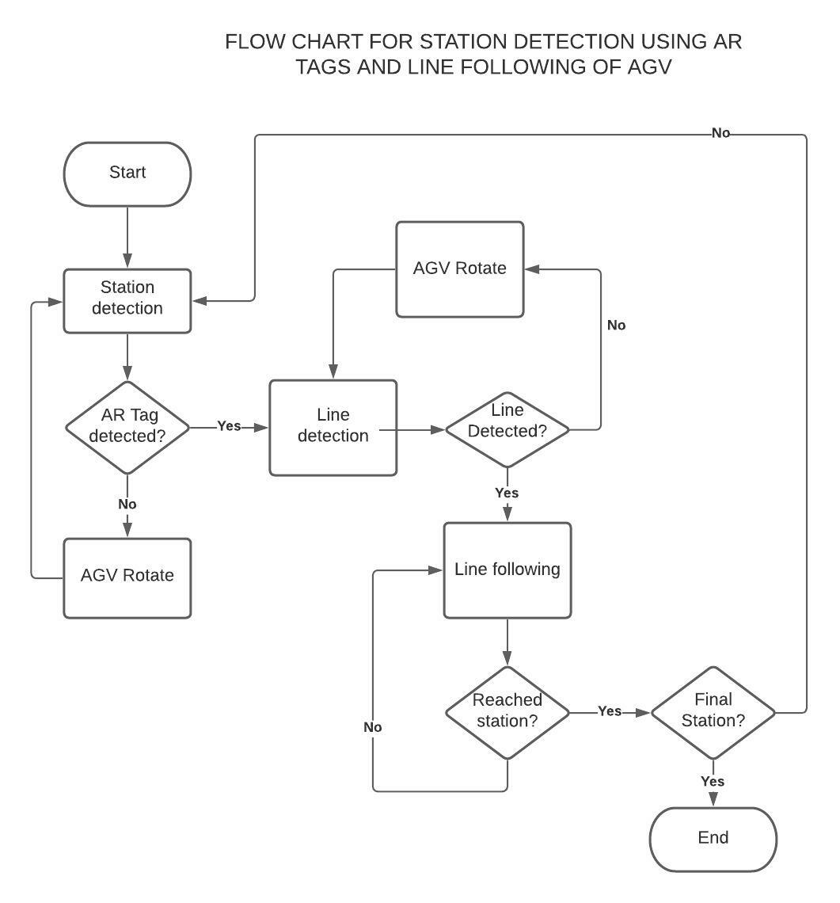
ROS Station detection
AR Tags

Slide 16
ROS Station detection
AR Tags
For the testing of AR Tag detection, ArUco markers were used.
Once the code was run and executed, the marker ID was detected, the location of its center point was obtained in terms of X and Y coordinates and ots orientation was shown when the marker was placed in front of the camera.

Slide 17
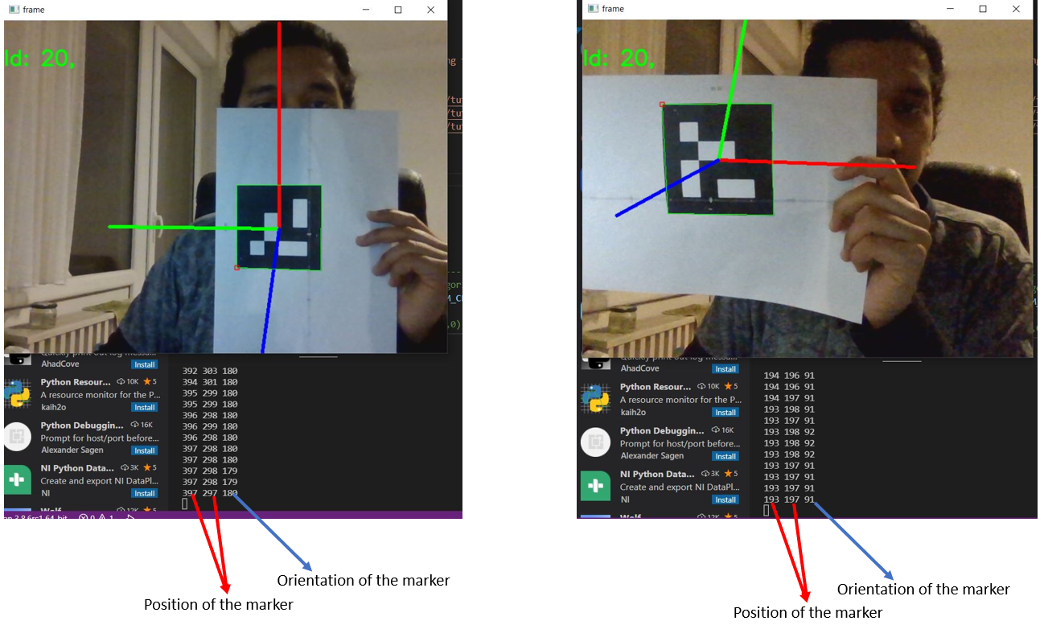
ROS Station detection
AR Tags

Slide 18
ROS Station detection
AR Tags – Further system development
AR Tag detection testing was done using the laptop web camera. It must be tested on a USB camera and must be implemented on ROS on Odroid.

Slide 19
ROS Station detection and localisation
RFID Tags
An alternate way to detect stations with line following, can also be as a redundant system with AR Tags. Further, it can be used for localisation of the bot.
RFID Tag detection was done which were detected by PN5180 -NFC Reader.
A NodeMCU ESP32 was used to test the PN5180 reader

Slide 20
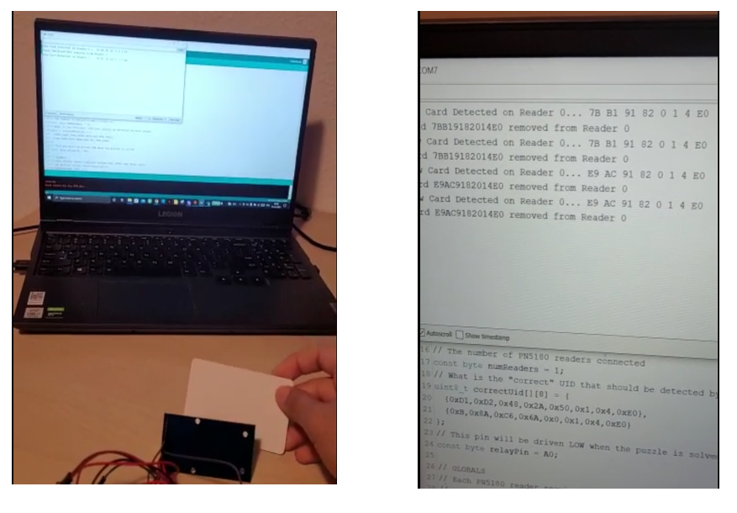
ROS Station detection and localisation
RFID Tags

Slide 21
ROS Station detection and localisation
The detection of RFID tags using the NFC Reader on nodeMCU ESP32 worked on SPI communication interface. To make it work on droid, the SPI interface had to be enabled on the Odroid.

Slide 22
ROS Station detection and localisation
SPI on Odroid
Device Tree Overlay was used to enable the GPIO functions.
Enabling the communication protocols SPI, I2C, UART and PWM using device tree overlay.
Enabling the SPI feature on the board.
To check the details of the GPIO of the Odroid, Wiringpi was installed and used.

Slide 23
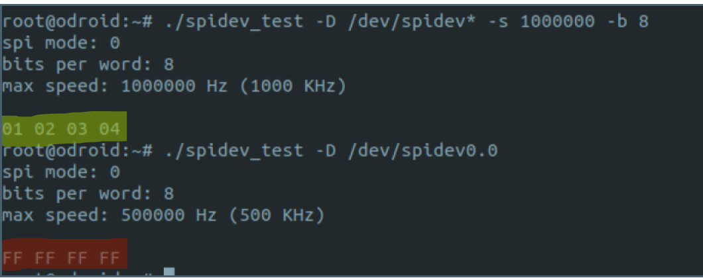
ROS Station detection and localisation
SPI on Odroid
Yellow indicates that the SPI MOSI(19) and MISO(21) pins are connected using a jump cable and the SPI communication is taking place between them and red indicates no connection.

Slide 24
ROS Station detection and localisation
Further system development
RFID Tags detection was tested using the PN5180 NFC reader using a NodeMCU ESP32. It works on SPI communication.
SPI communication on Odroid N2+ was enabled and further the code for RFID Tag detection has to be tested on Odroid N2+ using SPI Communication
It has to be implemented on ROS for an alternative way to detect stations and further for localisation and autonomous movement of the bot.

Slide 25
System Design ROS - Communication
Execution of speed test with
CAN interface
OPCUA server/client configuration
resulted in faster data rates of the CAN interface
> Toggle Digital Output by exchanging 8-bit variable
CAN | OPCUA
10 Hz | 0.5 Hz

Slide 26
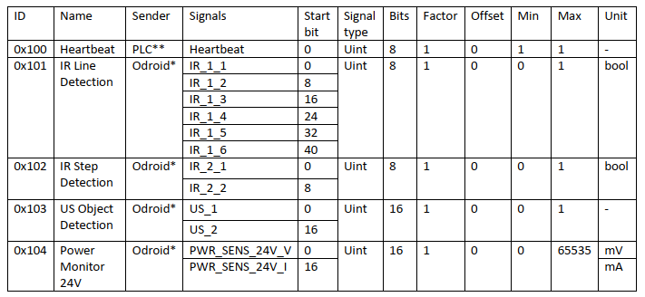
System Design ROS - Communication
Definition of AGV CAN Messages
Request & Response model

Slide 27
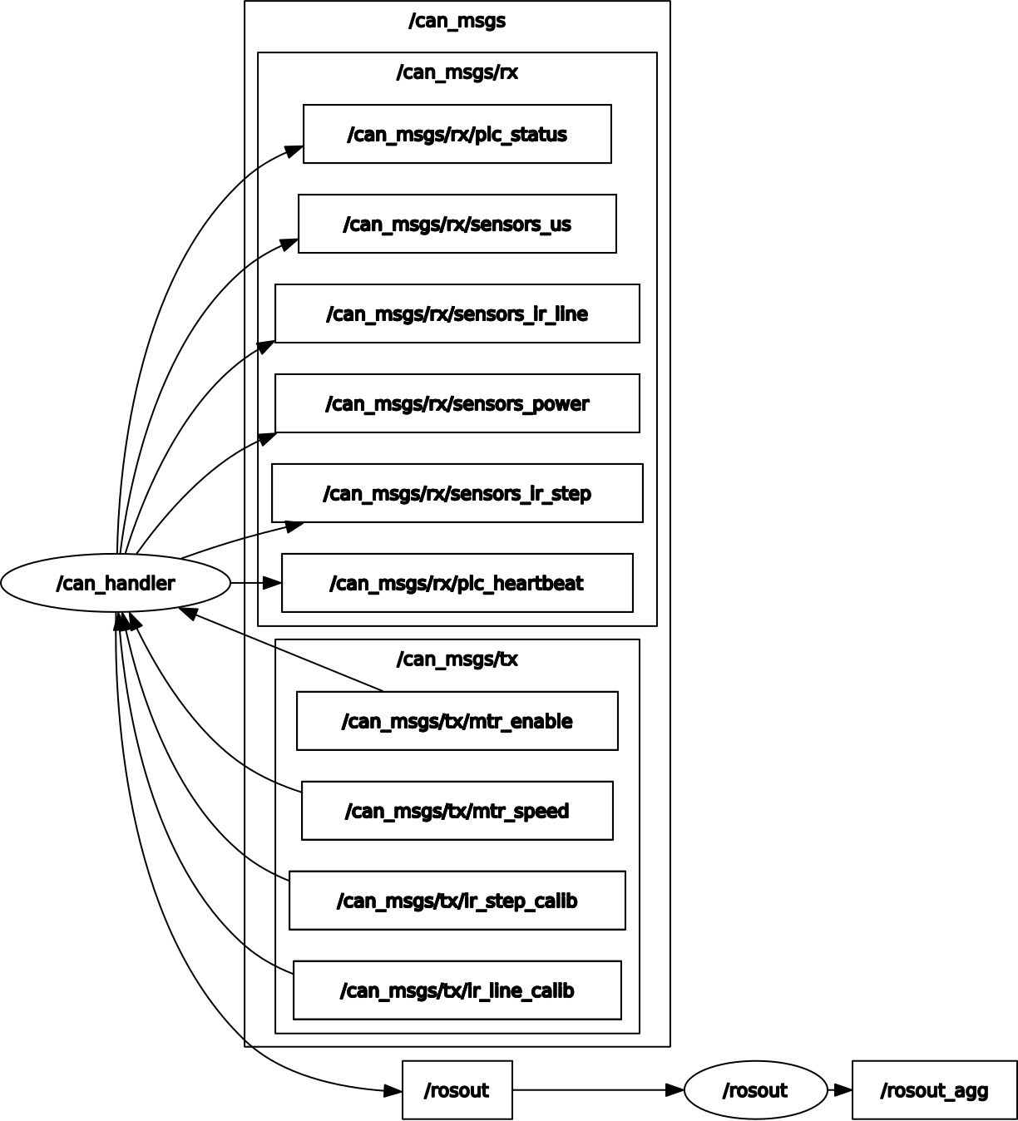
System Design ROS - Communication
Decoding / Encoding using Python Module cantools and CAN database file .dbc
Nodes subscribe to rx & tx topics to receive and send CAN messages

Slide 28
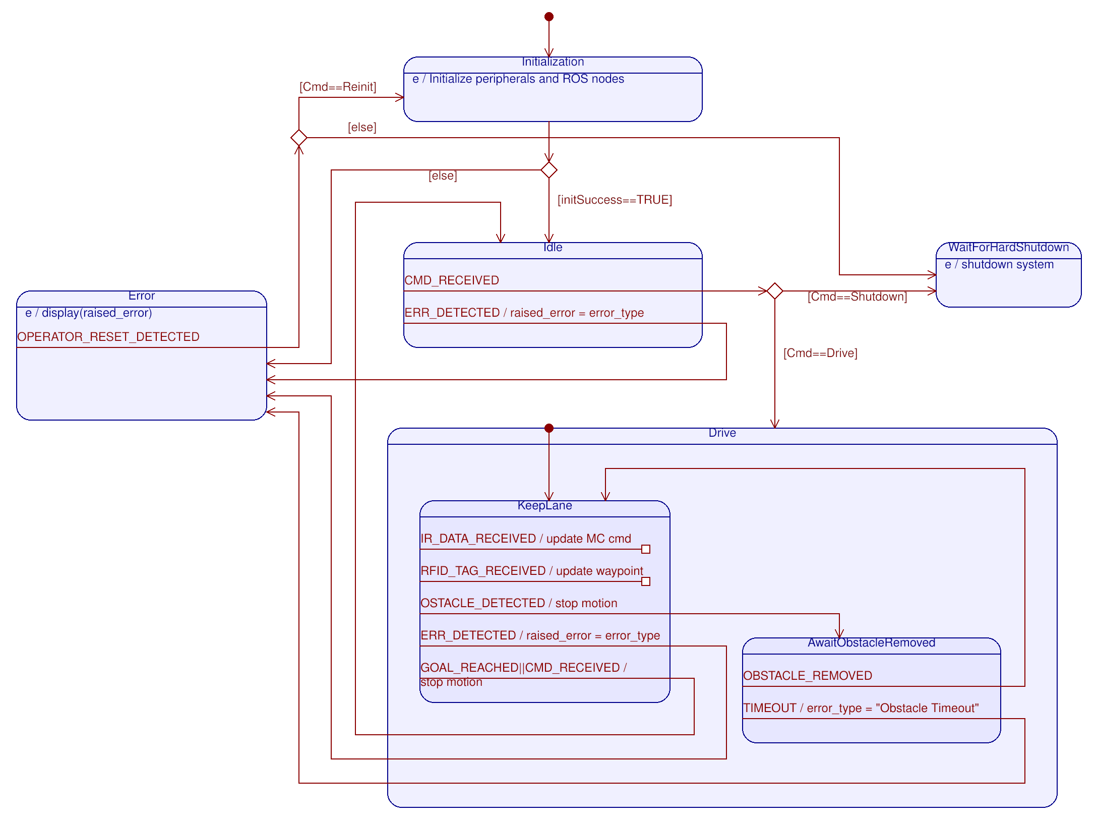
System Design ROS – State Machine

Slide 29
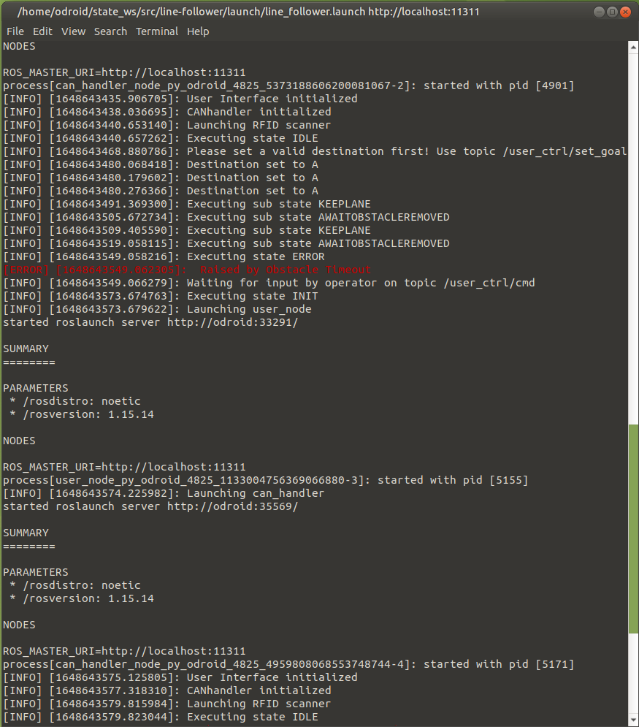
System Design ROS – State Machine
User Control interface via ROS Topic
Successful test with simulated PLC

Slide 30
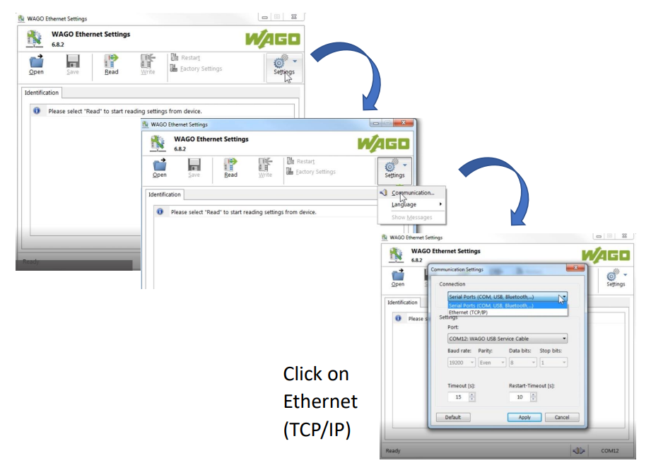
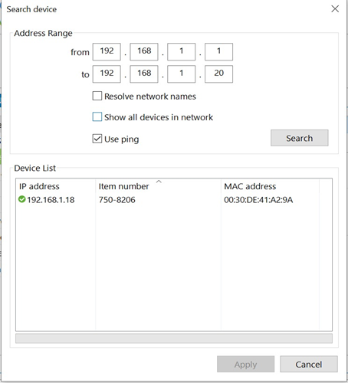
PLC Connecting to the Wago Ethernet Settings

Slide 31
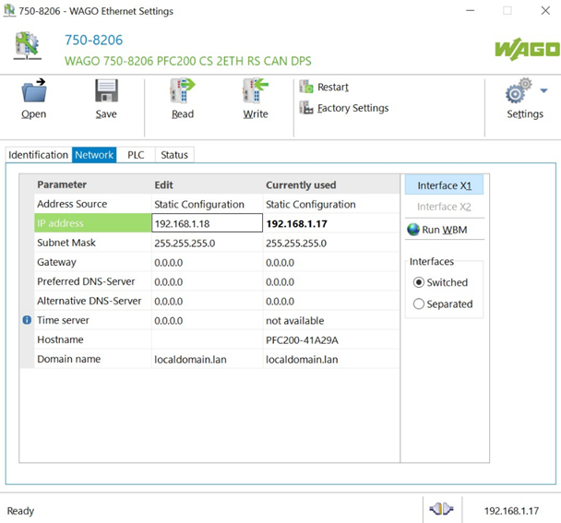
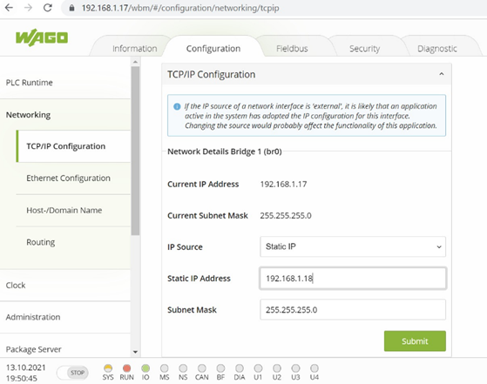
PLC Reset the PLC

Slide 32
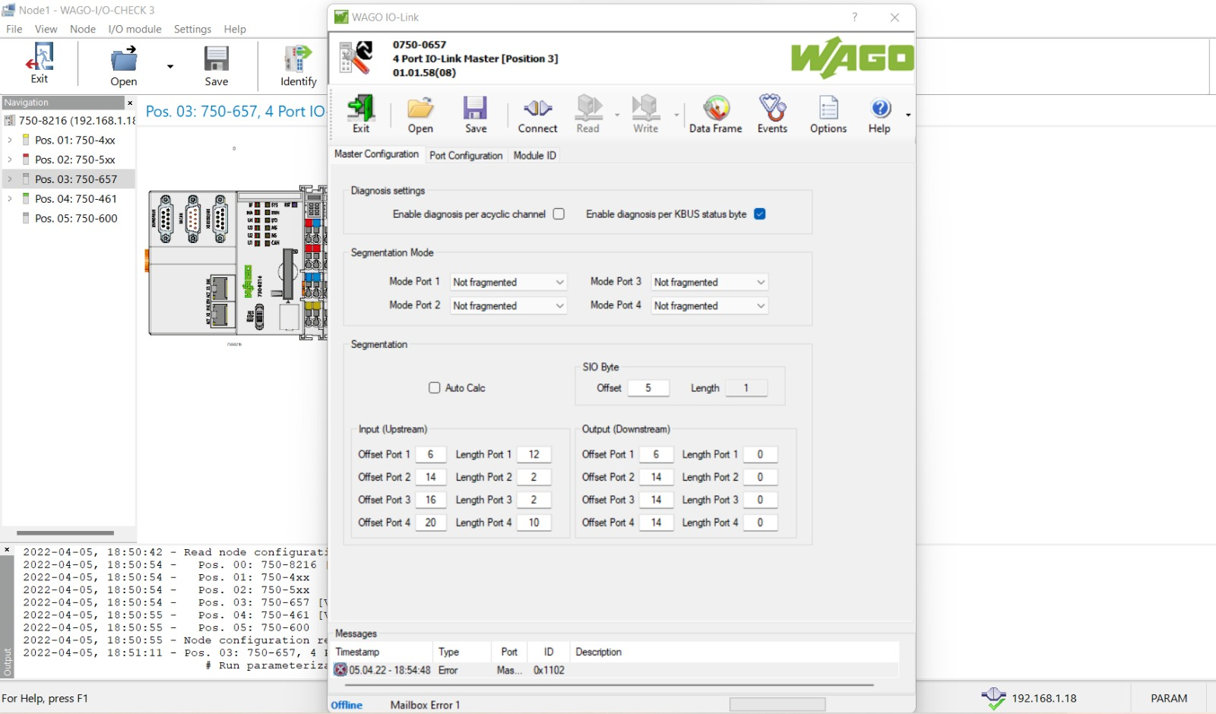
PLC Configure in IO-Check 3

Slide 33
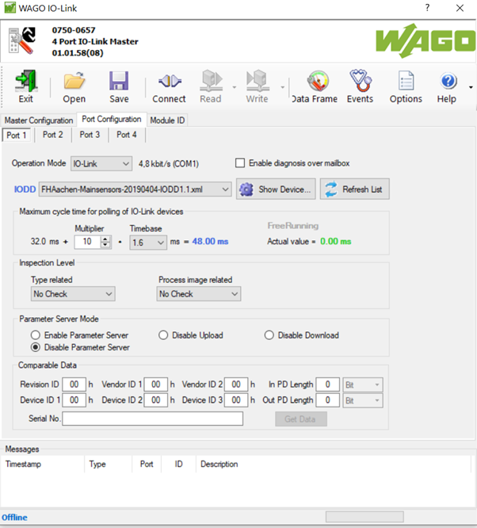
PLC Configure in IO-Check 3

Slide 34
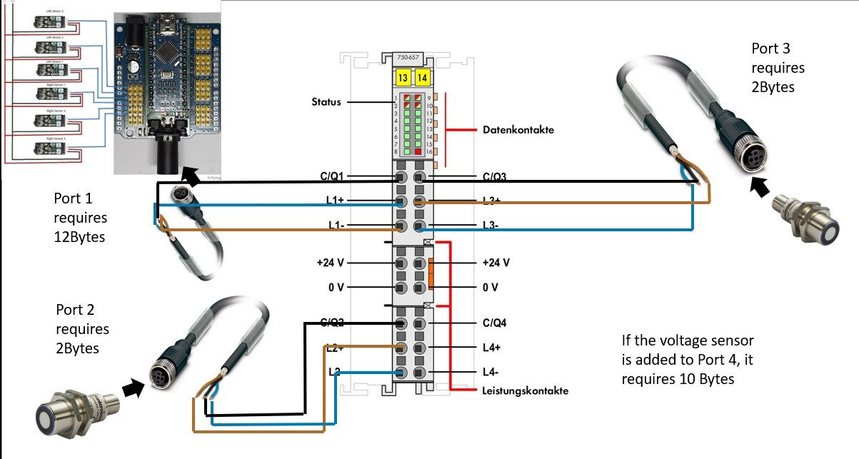
PLC Connecting the sensors to the PLC

Slide 35
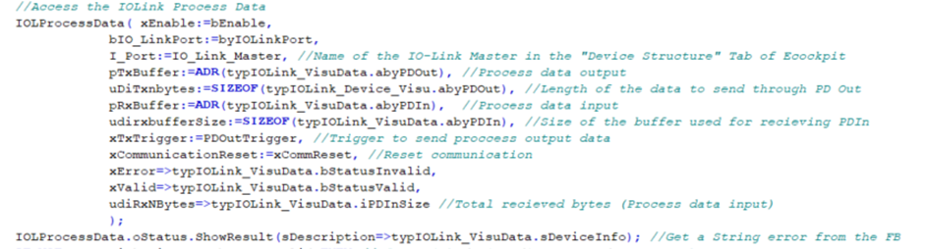
PLC IO Link Port Function Blocks
Port 1: IO shield connecting to 6 IR sensors
Port 2: Ultrasonic Sensor
Port 3: Ultrasonic Sensor
Port 4: IO shield connecting to Voltage sensor
Function Block Library:WagoAppIOLink
Function Block: FbIOL_PortData

Slide 36
PLC Why Microsonic Pico+35?
Variant with 90° angled head
IO-Link interface —> for support of the new industry standard
Automatic synchronisation and multiplex operation —> for simultaneous operation of up to ten sensors in close quarters
UL Listed to Canadian and US safety standards
Improved temperature compensation —> adjustment to working conditions within 120 seconds
Smart Sensor Profiles —> more transparency between IO-Link Devices

Slide 37
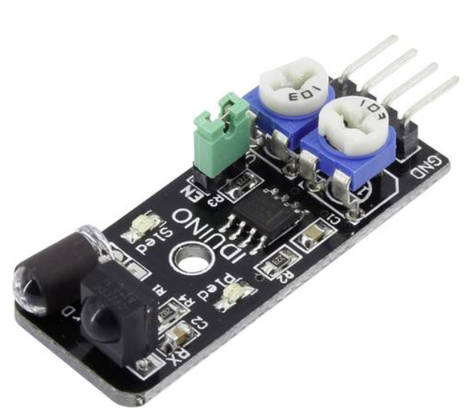
PLC IR Sensor for Line following
WHICH?
IDUINO IR SENSOR
WHY?
detection distance :2-40cm
Cost effective
Working voltage: DC 3.3V-5V
HOW MANY?
6 IR Sensors

Slide 38
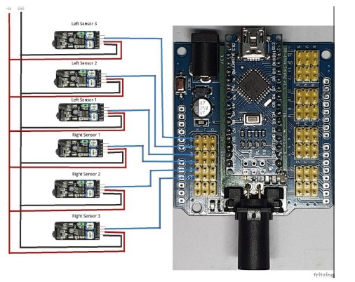
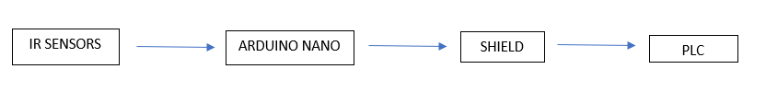
PLC IR sensor to Arduino Nano schematic diagram

Slide 39
PLC Softwares used
WAGO IO CHECK 3
To check the IO Link Communication
WAGO e!COCKPIT
To program the PLC
ARDUINO IDE
To program the Arduino
PYTHON 3.10
To communicate with the IFM IO Link Master

Slide 40
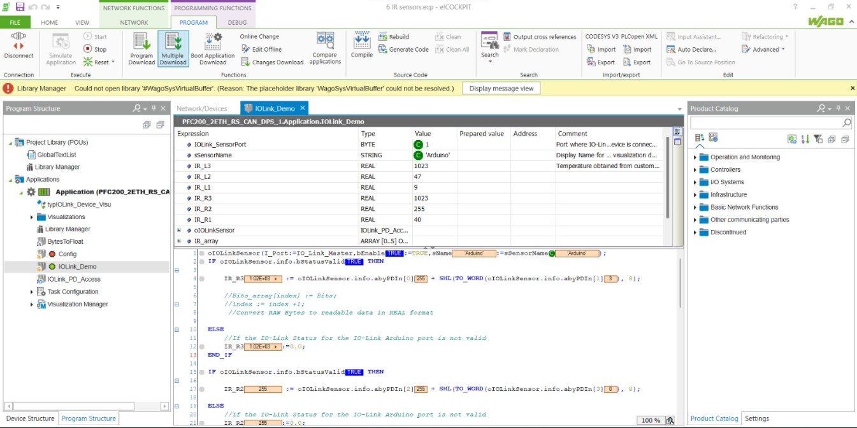
PLC IR sensor values

Slide 41
Power Supply Distribution
24 V (without DC/DC converter) – wire for connection used 6mm2 (uninterrupted current flow)
Motor Driver
Motors
Voltage Sensor (voltage measurement)
Fan
2. 24V (with DC/DC converter) – wire for connection 0.75 mm²
PLC
IFM
24V Sensors

Slide 42
Power Supply Distribution
3. 12V (with DC/DC converter) – wire for connection 0.75 mm²
Odroid N2+
4. 5V (with DC/DC converter) – wire for connection 0.75 mm²
Arduino Nano
5V Sensors

Slide 43
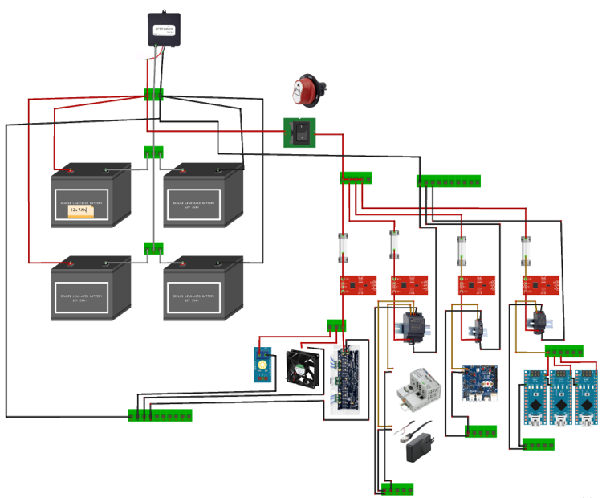
Power Supply Distribution

Slide 44
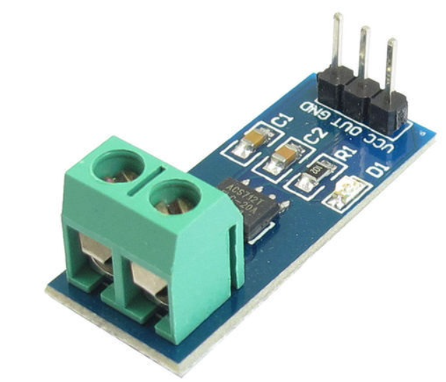
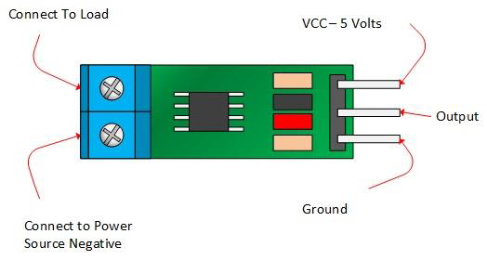
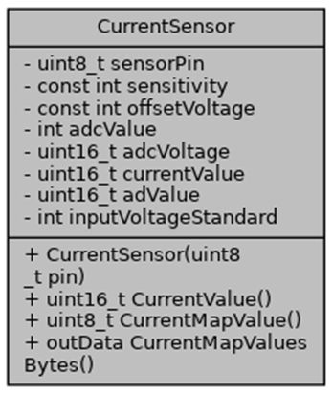
Power Supply Power monitoring sensors
Current sensor

Slide 45
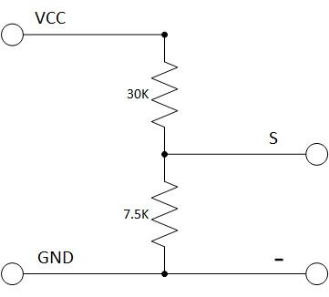
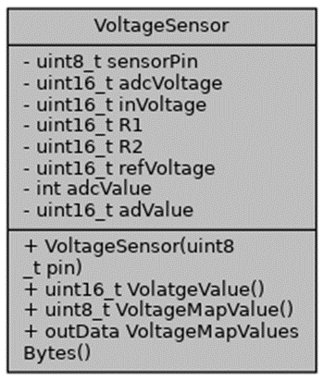
Power Supply Power monitoring sensors
Voltage sensor

Slide 46
Motor controller Ebike controller
Ebike controller is controlled using analog signal. The controller responds to analog signal between the range 1.2v to 3.8v.
To supply analog output, DAC MCP4725 is used. It is connected to Arduino nano using I2C communication.
For the project’s application, the MCP4725 receives commands from PLC via IO-Link Shield. The shield mounts Arduino nano to which the MCP4725 module is connected. The output (VOU pin) is connected to the respective motor controller.

Slide 47
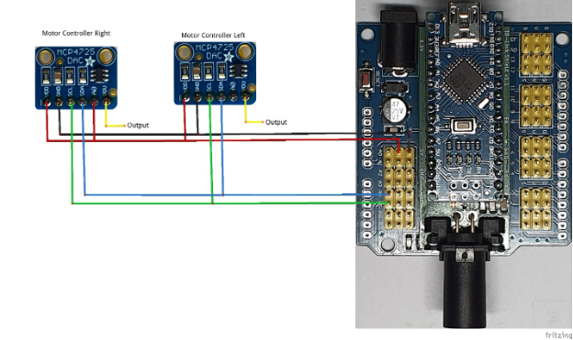
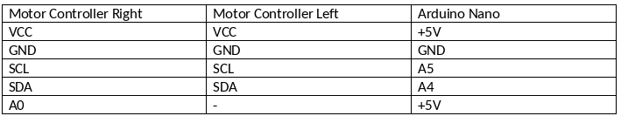
Motor controller Ebike controller

Slide 48
Motor controller Odrive controller
The project uses hoverboard BLDC motors. Odrive motor controller allows controlling two BLDC motors simultaneously using one board.
The commands can ve sent via various communication protocols such as UART, CAN and USB. The motors will be connected in similar manner. BLDC motors consists of hall sensors which are connected to ODrive board.

Slide 49
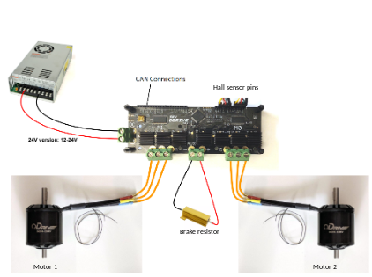
Motor controller Odrive controller

Slide 50
Motor controller Current status
The odrive motor controller had issues and the the controllers from the previous batch is being used now.

Slide 51
Motor controller
The data sent from the PLC is received by the IO-Link shield. The 7 bytes of data received is structured in the following order-
MTR_ESTOP, MTR_1_ENABLE, MTR_2_ENABLE, MTR_1_SPEED_H, MTR_1_SPEED_L, MTR_2_SPEED_H, MTR_2_SPEED_L.

Slide 52
Motor controller
The Arduino nano also sends feedback to the PLC via IO-Link communication. The data is of 6 bytes structured in the following order:
MTR_ESTOP_STATUS,MTR_ENABLE_STATUS,MTR_1_SPEED_STATUS_H,MTR_1_SPEED_STATUS_L, MTR_2_SPEED_STATUS_H, MTR_2_SPEED_STATUS_L.

Slide 53
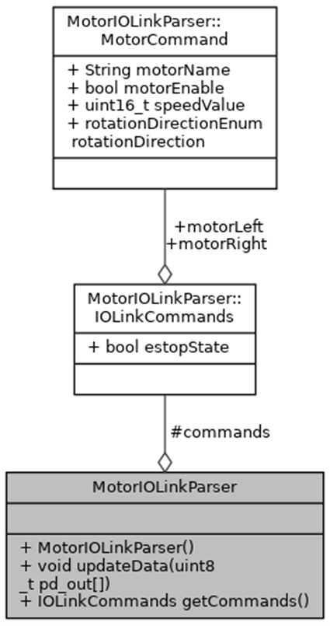
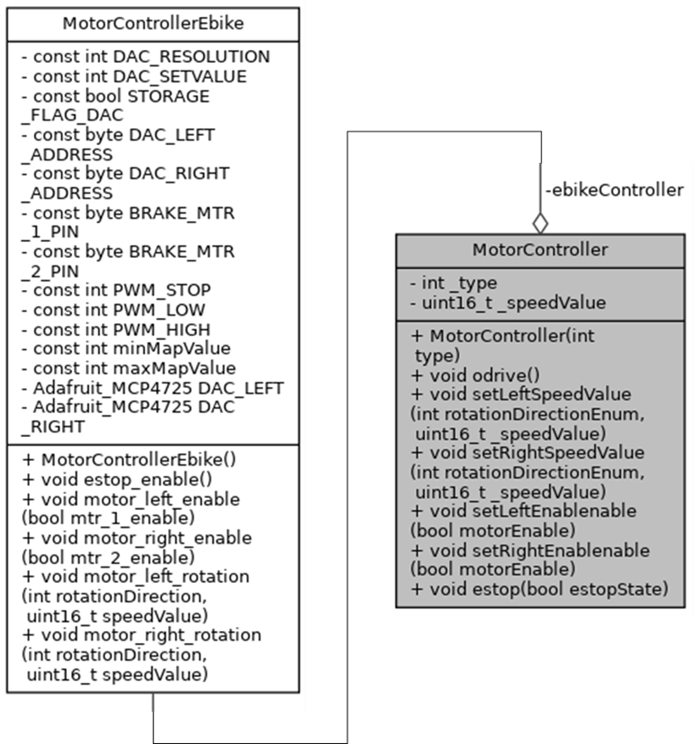
Motor controller

Slide 54
Lidar
For the low-cost project, we considered using RP LIDAR a1 by Slamtec.
The lidar can provide a variable frequency of 5Hz and 10Hz.
It can detect objects within the circumference with 12 meters radius

Slide 55
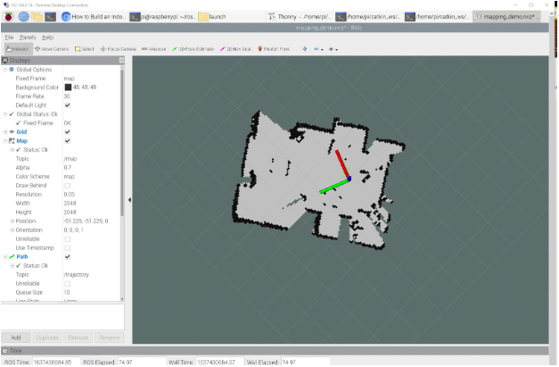
Lidar Future implementation for navigation with map generation

Slide 56
Conclusion & Outlook
Calibration has to be done
First Driving Tests to come
Path Planning Concept needs to be implemented

Slide 57
FH Aachen Faculty of Mechanical Engineering and Mechatronics Mechatronics Project: Autonomous Guided Vehicle Goethestr. 1 52064 Aachen

